Slide 1
Linux Operating system

Slide 2
Overview
Design Principles
Kernel Modules
Process Management
Scheduling
Memory Management
Inter-process Communication
Network Structure
Security

Slide 3
Linux
Linux is an open source operating system (OS). Linux was first developed as a small but self-contained kernel in 1991 by Linus Torvalds .
An operating system is the software that directly manages a system’s hardware and resources, like CPU, memory, and storage. The OS sits between applications and hardware and makes the connections between all of software and the physical resources that do the work.
The core Linux operating system kernel is entirely original, but it can run much existing free UNIX software, resulting in an entire UNIX-compatible operating system free from proprietary code.

Slide 4
How Linux works
Think about an OS like a car engine. An engine can run on its own, but it becomes a functional car when it’s connected with a transmission, axles, and wheels. Without the engine running properly, the rest of the car won’t work.
Linux was designed to be similar to UNIX , but has evolved to run on a wide variety of hardware from phones to supercomputers. Every Linux-based OS involves the Linux kernel—which manages hardware resources—and a set of software packages that make up the rest of the operating system.

Slide 5
Version of Linux
Version 0.01 (May 1991) :
Version 0.01 had no networking, ran only on 80386- compatible Intel processors and on PC hardware, had extremely limited device-drive support, and supported only the Minix file system.
Linux 1.0 (March 1994) :
Linux 1.0 included these new features:
1)Support for UNIX’s standard TCP/IP networking protocols .
2)BSD-compatible socket interface for networking programming .
3) Device-driver support for running IP over an Ethernet .
4) Enhanced file system .
5)Support for a range of SCSI controllers for high-performance disk access.
6)Extra hardware support.

Slide 6
Version of Linux
Version 1.2 (March 1995) :Version 1.2 was the final PC-only Linux kernel.
Odd version : Kernels with odd version numbers such as 1.1 or 2.5 ,are development kernels, those with even numbers are production kernels.
Version 2.4 and 2.6 : 2.4 and 2.6 increased SMP support, added journaling file system, preemptive kernel, 64-bit memory support
Version 3.0 :3.0 released in 2011, 20th anniversary of Linux, improved virtualization support, new page write-back facility, improved memory management, new Completely Fair Scheduler

Slide 7
Design Principles of Linux
Linux is a multiuser, multitasking system with a full set of UNIX-compatible tools.
Its file system adheres to traditional UNIX semantics, and it fully implements the standard UNIX networking model
Main design goals are speed, efficiency, and standardization.
Linux is designed to be compliant with the relevant POSIX documents; at least two Linux distributions have achieved official POSIX certification .
Supports Pthreads and a subset of POSIX real-time process control .
The Linux programming interface adheres to the SVR4 UNIX semantics, rather than to BSD behavior

Slide 8
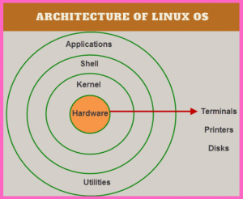
Architecture of Linux
The architecture of a Linux System consists of the following layers :
Hardware layer − Hardware consists of all peripheral devices (RAM/ HDD/ CPU ,etc).
Kernel − It is the core component of Operating System, interacts directly with hardware, provides low level services to upper layer components.
Shell − An interface to kernel, hiding complexity of kernel's functions from users. The shell takes commands from the user and executes kernel's functions.
Utilities − Utility programs that provide the user most of the functionalities of an operating systems.
Figure 1.1 Architecture of Linux

Slide 9
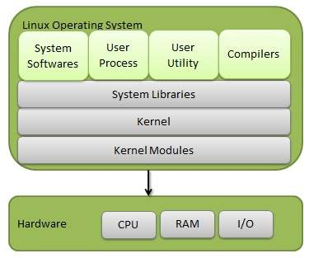
Components of a Linux System
Linux Operating System has primarily three components .They are:
1)Kernel: Kernel is the core part of Linux and it is responsible for maintaining the important abstractions of the operating system.
2)System Library: System libraries are special functions or programs using which application programs or system utilities accesses Kernel's features.
3)System Utility: system utilities perform individual specialized management tasks.
Figure 1.1 Components of Linux

Slide 10

Applications of Linux
Linux is today a multi-billion dollar company. Because of availability, cheaper license costs, and time and resources, thousands of businesses and government bodies are now using the Linux System.
Firefox is the standard browser for just a range of Linux distros including Ubuntu, Linux Mint, and others.
One of the many advantages is the easy and seamless interface of the application.
Figure 1.2 Applications of Linux

Slide 11
Kernel Modules
A kernel module is an object file that contains code to extend the running kernel of an operating systems. It is a standalone-file, typically used to add support for new hardware.
Kernel modules are usually stored in the /lib/modules subdirectories. The name of each subdirectory is based on the release number of the kernel:

Slide 12
Kernel Modules
Sections of kernel code that can be compiled, loaded, and unloaded independent of the rest of the kernel.
A kernel module may typically implement a device driver, a file system, or a networking protocol.
The module interface allows third parties to write and distribute, on their own terms, device drivers or file systems that could not be distributed under the GPL.
Kernel modules allow a Linux system to be set up with a standard, minimal kernel, without any extra device drivers built in.

Slide 13
Kernel Modules
There are 4 components to Linux module support. They are:
1) module-management system .
2) module loader and unloader .
3)driver-registration system .
4) conflict-resolution mechanism.
Module Management:
The module requestor manages loading requested, but currently unloaded, modules; it also regularly queries the kernel to see whether a dynamically loaded module is still in use, and will unload it when it is no longer actively needed.

Slide 14
Process Management
The process is a program in execution. The process is created when a command is to be executed so, it can be called a running instance of a program in execution. Tuning or controlling a process is called Process Management.
Starting a Process:
While starting a process (run a command), there are two ways to run.
1)Foreground Processes: By default, every process that we start runs in the foreground. It gets its input from the keyboard and sends its output to the screen.
2)Background Processes: A background process runs without being connected to your keyboard. If the background process requires any keyboard input

Slide 15
Process Management
The fork() system call creates a new process and a new program is run after a call to exec() are two distinct operations to create of processes and the running of a new program.
Under UNIX, a process encompasses all the information that the operating system must maintain to track the context of a single execution of a single program
Under UNIX, a process encompasses all the information that the operating system must maintain to track the context of a single execution of a single program .

Slide 16
Process Properties:
Under Linux, process properties fall into three groups: the process’s identity, environment, and context.
1)Process ID (PID) - The unique identifier for the process; used to specify processes to the operating system when an application makes a system call to signal, modify, or wait for another process .
2) Credentials - Each process must have an associated user ID and one or more group IDs that determine the process’s rights to access system resources and files.
3) Personality - Not traditionally found on UNIX systems, but under Linux each process has an associated personality identifier that can slightly modify the semantics of certain system calls .
Used primarily by emulation libraries to request that system calls be compatible with certain specific flavors of UNIX .
Namespace – Specific view of file system hierarchy

Slide 17
process environment
The process’s environment is inherited from its parent, and is composed of two null-terminated vectors:
The argument vector lists the command-line arguments used to invoke the running program; conventionally starts with the name of the program itself.
The environment vector is a list of “NAME=VALUE” pairs that associates named environment variables with arbitrary textual values.

Slide 18
Processes and threads
1)Linux uses the same internal representation for processes and threads; a thread is simply a new process that happens to share the same address space as its parent .
Both are called tasks by Linux
2) A distinction is only made when a new thread is created by the clone() system call
fork() creates a new task with its own entirely new task context . clone() creates a new task with its own identity, but that is allowed to share the data structures of its parent .
3) Using clone() gives an application fine-grained control over exactly what is shared between two threads.

Slide 19
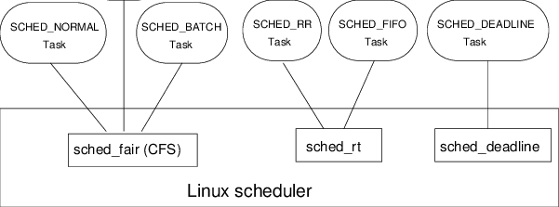
Scheduling
Scheduling of processes is one of the most important aspects or roles of any operating system.
A Process Scheduler deals with processes scheduling in Linux. Process Scheduler uses Scheduling Algorithms that helps in deciding the process to be executed.

Slide 20
Scheduling
1)The job of allocating CPU time to different tasks within an operating system .
2) While scheduling is normally thought of as the running and interrupting of processes, in Linux, scheduling also includes the running of the various kernel tasks
3)Running kernel tasks encompasses both tasks that are requested by a running process and tasks that execute internally on behalf of a device driver .
4 )As of 2.5, new scheduling algorithm – preemptive, priority-based, known as O(1)
Real-time range .
nice value .
Had challenges with interactive performance .
5) 2.6 introduced Completely Fair Scheduler (CFS)
6) For time-sharing processes, Linux uses a prioritized, credit based algorithm. – The crediting rule is (credits = credits /2 + priority)

Slide 21
CFS
1)Eliminates traditional, common idea of time slice.
N runnable tasks means each gets 1/N of processor’s time
Then weights each task with its nice value
Smaller nice value -> higher weight (higher priority)
Then each task run with for time proportional to task’s weight divided by total weight of all runnable tasks
Configurable variable target latency is desired interval during which each task should run at least once
Instead all tasks allocated portion of processor’s time
CFS calculates how long a process should run as a function of total number of tasks

Slide 22
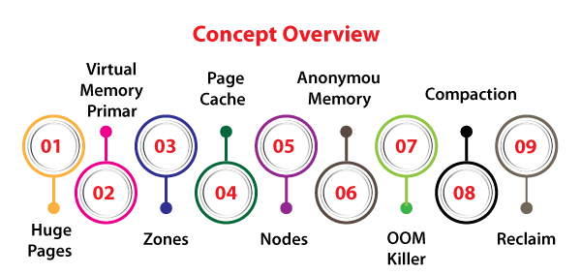
Memory Management
Linux memory management is responsible to manage the memory inside the system. It contains the implementation of demand paging and virtual memory.
Also, it contains memory allocation for user space programs and kernel internal structures. Linux memory management subsystem includes files mapping into the address space of the processes and several other things.
Linux memory management subsystem is a complicated system with several configurable settings.
Figure : Memory Management of Linux

Slide 23
Memory Management
1)Linux’s physical memory-management system deals with allocating and freeing pages, groups of pages, and small blocks of memory
2) It has additional mechanisms for handling virtual memory, memory mapped into the address space of running processes .
3) Splits memory into four different zones due to hardware characteristics
Architecture specific, for example on x86:

Slide 24
Managing Physical Memory
The page allocator allocates and frees all physical pages; it can allocate ranges of physically-contiguous pages on request .
The allocator uses a buddy-heap algorithm to keep track of available physical pages .
Each allocatable memory region is paired with an adjacent partner .
Whenever two allocated partner regions are both freed up they are combined to form a larger region.
If a small memory request cannot be satisfied by allocating an existing small free region, then a larger free region will be subdivided into two partners to satisfy the request
Page cache and virtual memory system also manage physical memory.

Slide 25
Virtual Memory
The VM system maintains the address space visible to each process: It creates pages of virtual memory on demand, and manages the loading of those pages from disk or their swapping back out to disk as required.
The VM manager maintains two separate views of a process’s address space:
a)A logical view describing instructions concerning the layout of the address space
The address space consists of a set of non-overlapping regions, each representing a continuous, page-aligned subset of the address space .
b) A physical view of each address space which is stored in the hardware page tables for the process

Slide 26
Swapping & paging
The VM paging system relocates pages of memory from physical memory out to disk when the memory is needed for something else The VM paging system can be divided into two sections:
The pageout-policy algorithm decides which pages to write out to disk, and when
The paging mechanism actually carries out the transfer, and pages data back into physical memory as needed
Can page out to either swap device or normal files
Bitmap used to track used blocks in swap space kept in physical memory
Allocator uses next-fit algorithm to try to write contiguous runs.

Slide 27
File system
To the user, Linux’s file system appears as a hierarchical directory tree obeying UNIX semantics
Internally, the kernel hides implementation details and manages the multiple different file systems via an abstraction layer, that is, the virtual file system (VFS)
The Linux VFS is designed around object-oriented principles and is composed of four components:
A set of definitions that define what a file object is allowed to look like
1)The inode object structure represent an individual file
2) The file object represents an open file
3)The superblock object represents an entire file system
4) A dentry object represents an individual directory entry

Slide 28
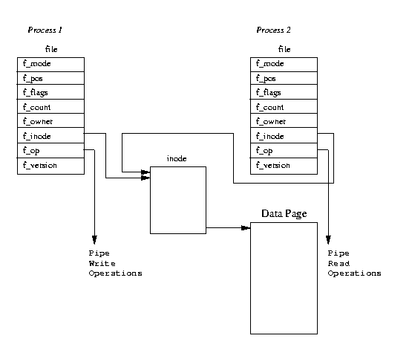
Inter-process Communication
Inter Process Communication (IPC) refers to a mechanism, where the operating systems allow various processes to communicate with each other.
The Linux kernel provides the following IPC(Inter-process Communication) mechanisms:
Signals, Anonymous Pipes, Named Pipes or FIFOs, SysV Message Queues, POSIX Message Queues, SysV Shared memory, POSIX Shared memory,, FUTEX locks,UNIX Domain Sockets, etc.

Slide 29
Inter-process Communication
Like UNIX, Linux informs processes that an event has occurred via signals There is a limited number of signals, and they cannot carry information: Only the fact that a signal occurred is available to a process
The Linux kernel does not use signals to communicate with processes with are running in kernel mode, rather, communication within the kernel is accomplished via scheduling states and wait_queue structures
Also implements System V Unix semaphores
1)Process can wait for a signal or a semaphore
2) Semaphores scale better
3)Operations on multiple semaphores can be atomic

Slide 30
Passing Data between Processes
The pipe mechanism allows a child process to inherit a communication channel to its parent, data written to one end of the pipe can be read a the other
Shared memory offers an extremely fast way of communicating; any data written by one process to a shared memory region can be read immediately by any other process that has mapped that region into its address space
To obtain synchronization, however, shared memory must be used in conjunction with another Interprocess communication mechanism

Slide 31
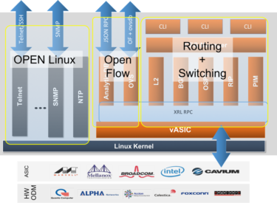
Network Structure
The network structure in a Linux operating system gets a bit complicated. By itself, Linux does not address networking; it is, after all, a server operating system intended to run applications, not networks. OpenStack, however, does provide a networking service that’s meant to be used with Linux.
OpenStack is a combination of open source software tools for building and managing virtualized cloud computing services, providing services including compute, storage and identity management.
Figure : Network Structure of Linux

Slide 32
Network Structure
1)Networking is a key area of functionality for Linux
It supports the standard Internet protocols for UNIX to UNIX communications
It also implements protocols native to non-UNIX operating systems, in particular, protocols used on PC networks, such as Appletalk and IPX
2) Internally, networking in the Linux kernel is implemented by three layers of software:
The socket interface
Protocol drivers
Network device drivers
3) Most important set of protocols in the Linux networking system is the internet protocol suite
It implements routing between different hosts anywhere on the network
On top of the routing protocol are built the UDP, TCP and ICMP protocols
4)Packets also pass to firewall management for filtering based on firewall chains of rules

Slide 33
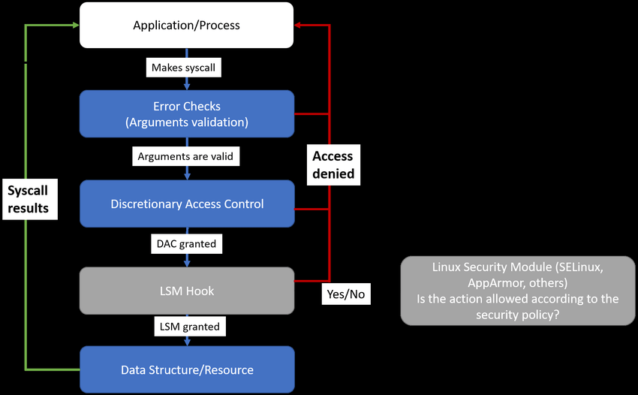
Security
Linux systems are rarely infected by malware such as viruses, worms ,etc. thereby making it as a very secure OS.
As a normal user, we will never come across a situation where Antivirus software is been sold for Linux. This means, Linux is inherently secure and there are many reasons associated with it.
Figure : Linux Security Modules hooks

Slide 34
Security
The pluggable authentication modules (PAM) system is available under Linux
PAM is based on a shared library that can be used by any system component that needs to authenticate users
Access control under UNIX systems, including Linux, is performed through the use of unique numeric identifiers (uid and gid)
Access control is performed by assigning objects a protections mask, which specifies which access modes—read, write, or execute—are to be granted to processes with owner, group, or world access

Slide 35
Security
Linux augments the standard UNIX setuid mechanism in two ways:
a)It implements the POSIX specification’s saved user-id mechanism, which allows a process to repeatedly drop and reacquire its effective uid.
b) It has added a process characteristic that grants just a subset of the rights of the effective uid.
Linux provides another mechanism that allows a client to selectively pass access to a single file to some server process without granting it any other privileges

